Slide 1
BARC Tube Bending Week 6

Slide 2
Checklist
Process: Manual Edge detection Smoothing edges Fitting lines to straight sections Angle Calculation Part 1 ( Bends 1 & 2) Part 2 ( Bends 2,3 & 4) Automated Edge detection Smoothing edges Fitting lines to straight sections Angle Calculation Part 1 ( Bends 1 & 2) Part 2 ( Bends 2,3 & 4) | Varying Parameters: Background Color Background Brightness Distance to LED box Height of camera Camera Orientation Lighting (Front vs Back) Different cameras/lenses Adding noise (non-ideal lighting conditions) No. of Cameras

Slide 3
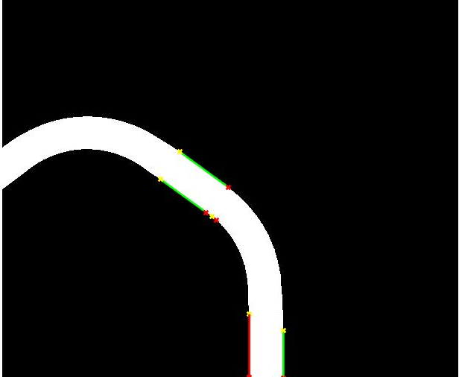
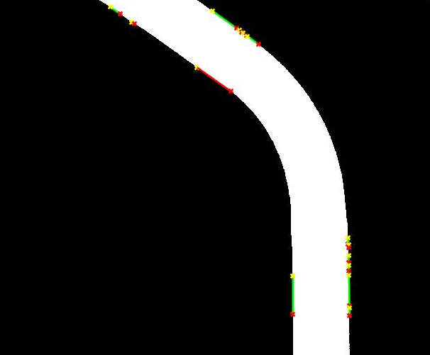
3. Last Week Result: Angle error Comparison - Varying distance
Observation Distance: 33.5 in Angle error = 0.6162 Resolution = 634.328 Px/in | Observation Distance: 21 in Angle error = 0.0361 degrees Resolution = 1011.9 Px/in
Observation:
Closer distance
More pixels per length
Lesser angle error

Slide 4
Current Week Effort
Angle Error Plot Trend:
Obtain a plot of angle error vs no. of pixels in an ideal straight line for the bend angles of the training samples
Gain insights on resolution required to be below threshold error (0.1 degrees)
Compare with real errors:
Take images obtained from two different heights and use houghlines function to fit straight lines to the edges
Use smoothing for the edges
Calculate errors and compare with ideal line error plot trend

Slide 5
Current Week Effort
Conclude whether increasing the number of pixels really leads to a decrease in angle error:
See if the images obtained from a closer height give a smaller error.
Decrease the number of pixels used to calculate angle and see if this increases error.
See if error trend from real system and the ideal line match.

Slide 6
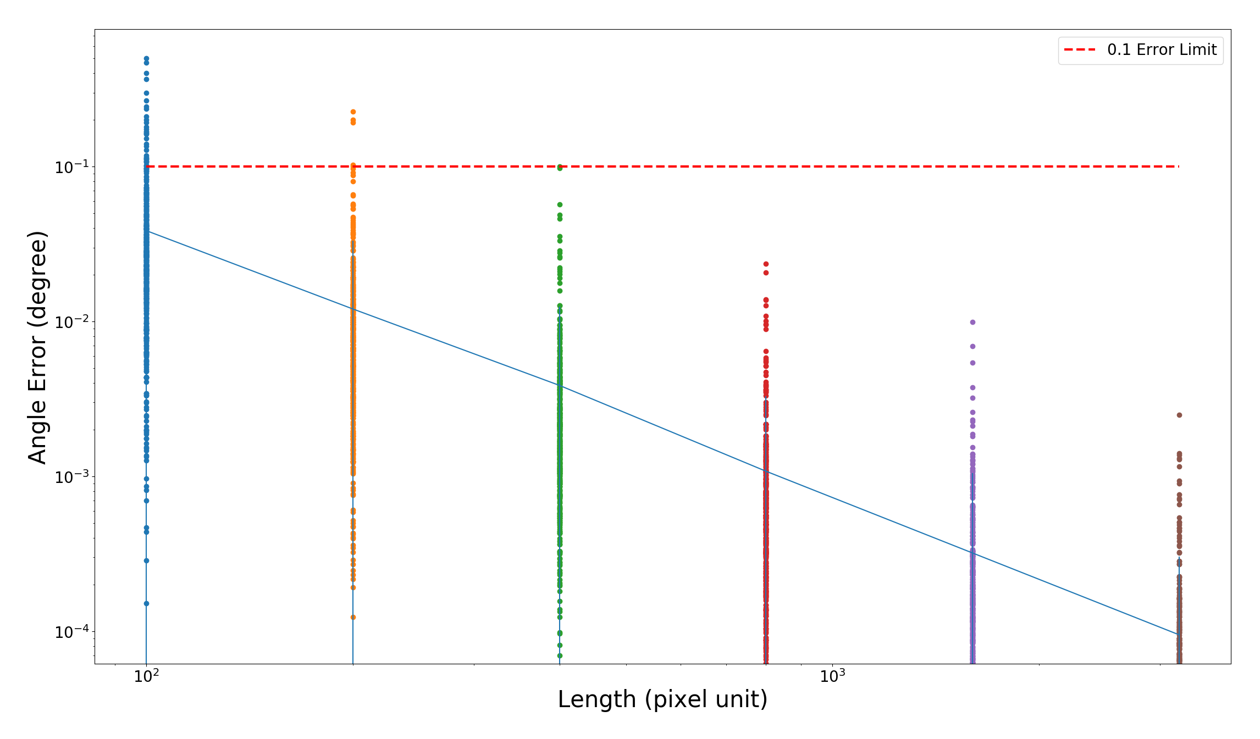
1.2 Angle Error Plot Trend: Plot (Mean)
For each length, find the error of a range of angles and get the mean
The error is decreasing linearly as the length increasing.

Slide 7
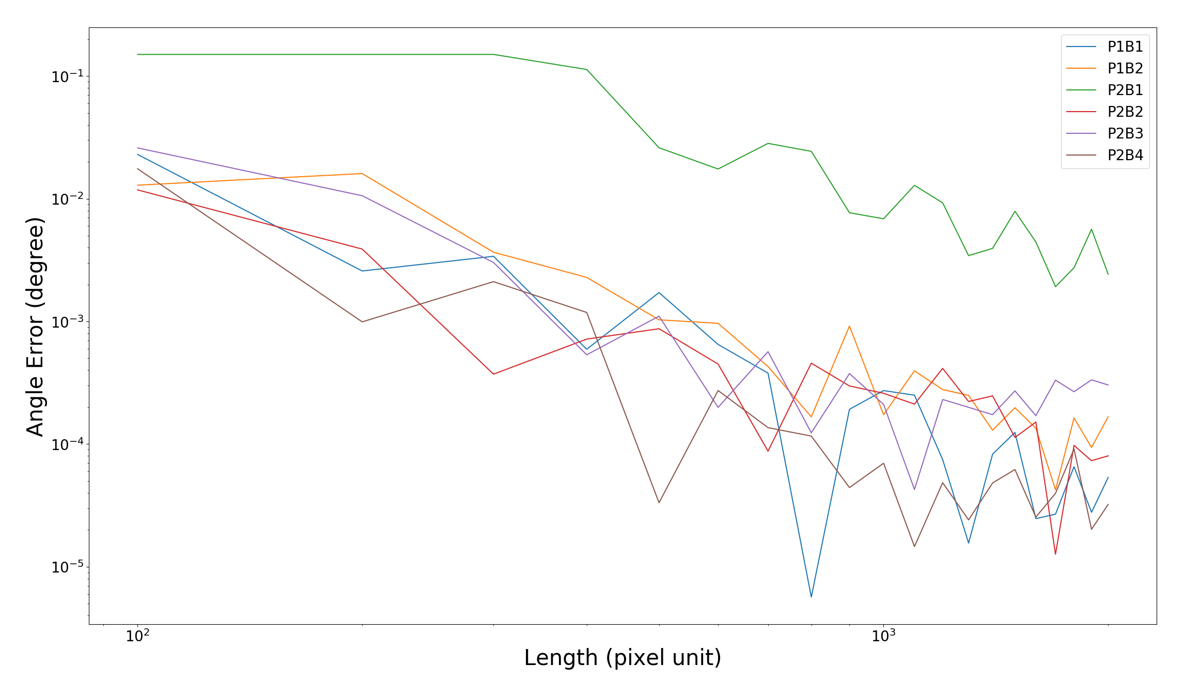
1.2 Angle Error Plot Trend: Plot (Sample)
For given angle, the error is decreasing but fluctuating heavily.
Cannot guarantee less error with more pixels.

Slide 8
1.2 Angle Error Plot Trend: Plot (Shifting)

Slide 9
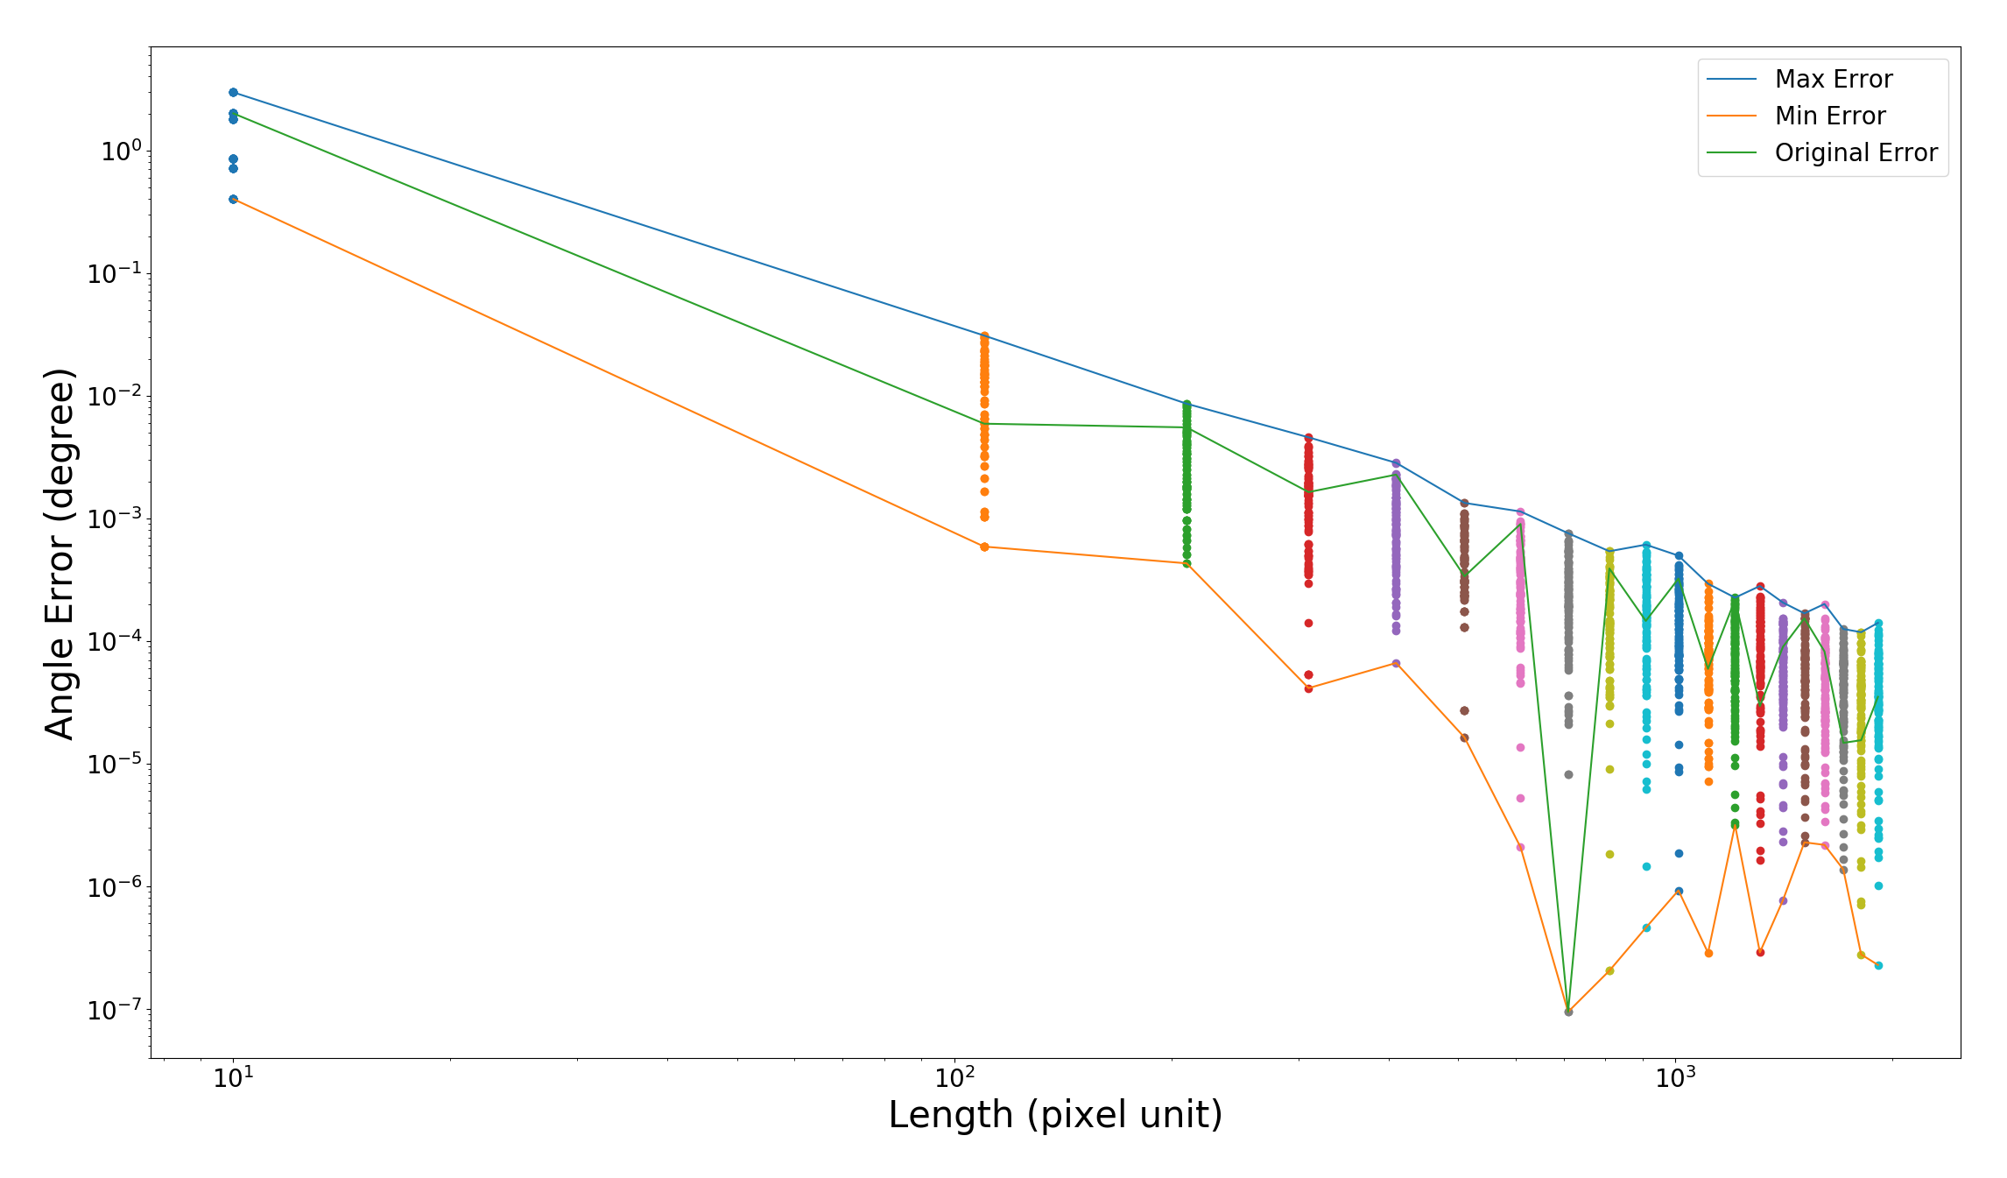
1.2 Angle Error Plot Trend: Plot (Shifting)
For given angle, shifting the line by different offset and get the error.

Slide 10
1.2 Insights from Ideal error plot trend
Even though there is variability in error for a certain number of pixels used in each angle estimation (caused by pixelation), the max error decreases with increasing number of pixels for all the angles.

Slide 11
2.1 Calculating angles of Bends
Using MATLAB’s edge function get the edges of the bend.
Smooth the edges using the ‘canny’ option in the edge function and MATLAB’s dilate function
Use Houghlines to fit lines to straight sections of edges
Calculate angles from the lines outputted by Houghlines

Slide 12
2.1 Bend Angle Calculation Contd.
Houghlines fits multiple lines to each straight section
We calculated the angles between all lines and found the lines that gave least error
We then calculated the angles between the longest lines of each section because we wanted to see if the longest lines gave the smallest error.

Slide 13
2.4 Insights from Calculating angle error using sections of different length
Smoothing improved accuracy of angle estimation
In general using longer sections does not give better results
What matters more than the length of section is how “clean” each section used is
We also found that smoothing is helpful in decreasing angle error

Slide 14
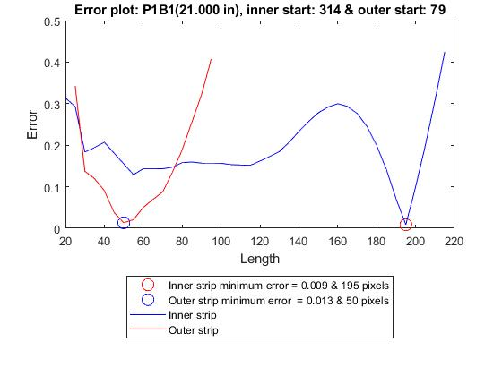

Slide 15
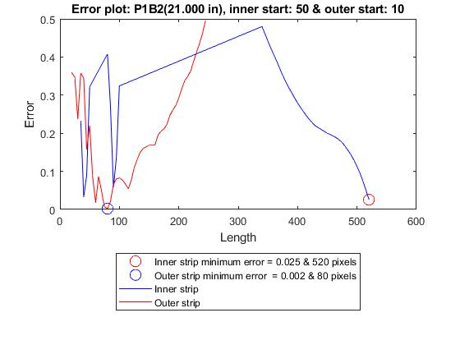

Slide 16
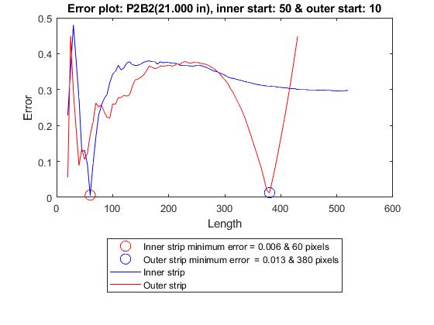

Slide 17
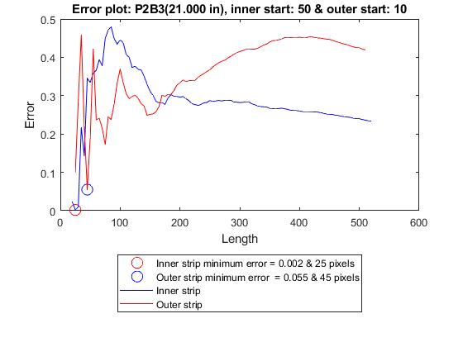

Slide 18
Insights from repeating angle calculation for a longer distance
Again as we increased number of pixels the angle error did not go down.
But minimum error was lesser when the distance between camera and tube was 21 inches
We conclude that the ideal line error trend is not a good predictor of the real system.

Slide 19
Table of errors for 21 in distance
 | Min Error | Long section left edge error | Long section right edge error | Ideal line error (max)
P1B1 | 0.0516 | 0.1573 | 0.1573 | 0.039
P1B2 | 0.0636 | 0.0636 | 0.2948 | 0.0142
P2B2 | 0.0464 | 0.3332 | 1.1086 | 0.067
P2B3 | 0.0120 | 0.0669 | 0.0120 | 0.005
P2B4 | 0.0200 | 1.0430 | 1.4415 | 0.323

Slide 20
Table of errors for 33.5 in distance
 | Min Error | Long section left edge error | Long section right edge error | Ideal line error (max)
P1B1 | 0.1573 | 0.3325 | 0.1573 | 0.0065
P1B2 | 0.6252 | 0.6568 | 0.6252 | 0.022
P2B2 | 0.0955 | 0.2526 | 0.3073 | 0.923
P2B3 | 0.0669 | 0.0709 | 0.0669 | 0.0055
P2B4 | 0.4362 | 0.4362 | 0.4485 | 0.0038

Slide 21
Future work
Make the houghlines algorithm robust, (sometimes it misses certain straight sections)
Houghlines fits many straight lines to the straight sections, we need to automate choosing the lines that will give most accurate measure of bend angle.
Take images of bend from different heights and calculate bend angle from the images. Obtain a relation to find the minimum no. of pixels needed to get below the error threshold as a function of tube length and height of camera.

